Slide 1
PAM generation and Reconstruction
Expt. No- 8

Slide 2
Pulse Amplitude Modulation:
Pulse amplitude modulation is a technique in which the amplitude of each pulse is controlled by the instantaneous amplitude of the modulation signal.
It is a modulation system in which the signal is sampled at regular intervals and each sample is made proportional to the amplitude of the signal at the instant of sampling.
This technique transmits the data by encoding in the amplitude of a series of signal pulses.

Slide 3
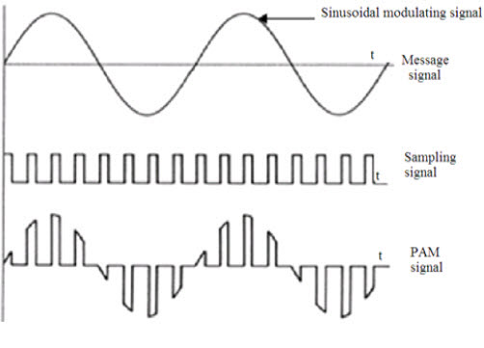
Waveform:

Slide 4
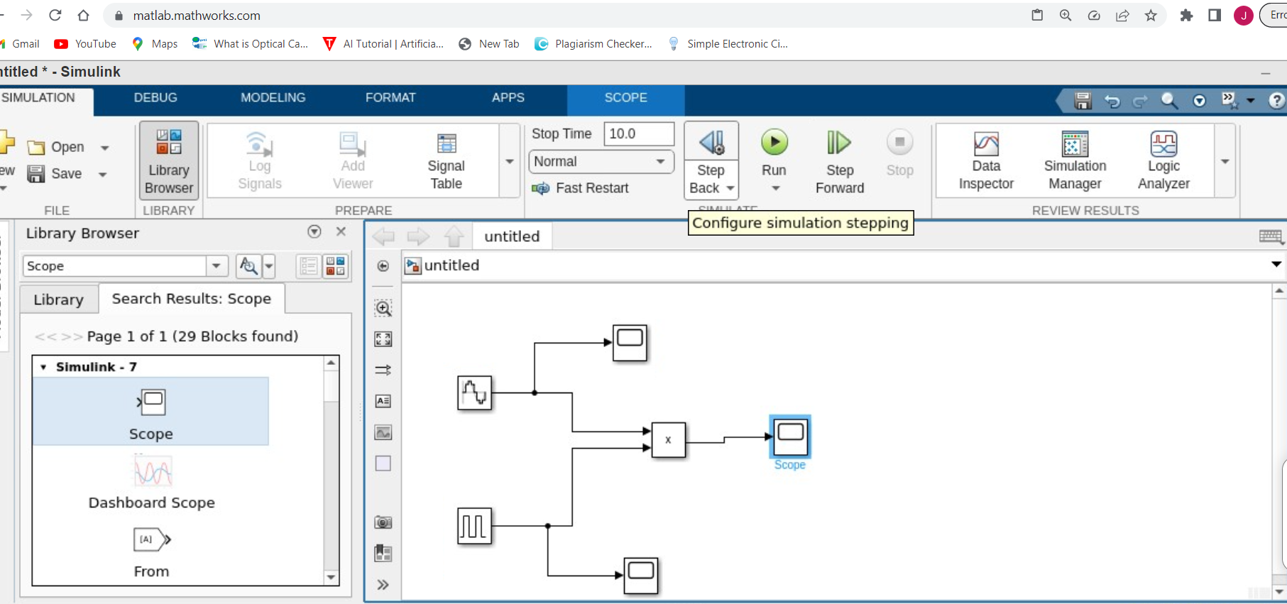
MATLAB Simulink:

Slide 5
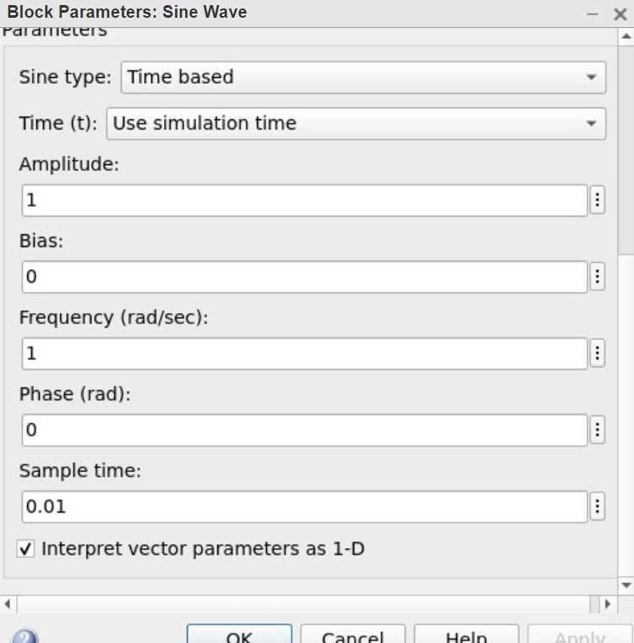
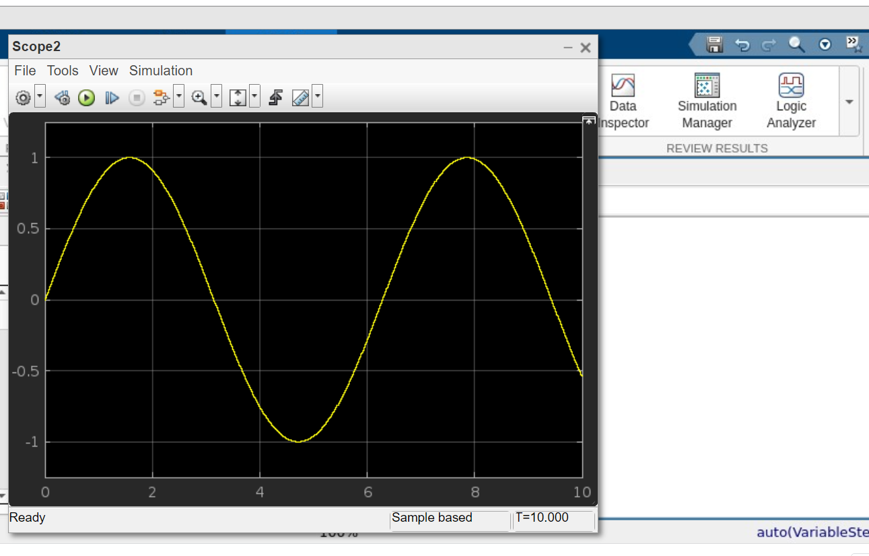
Sine Wave:

Slide 6
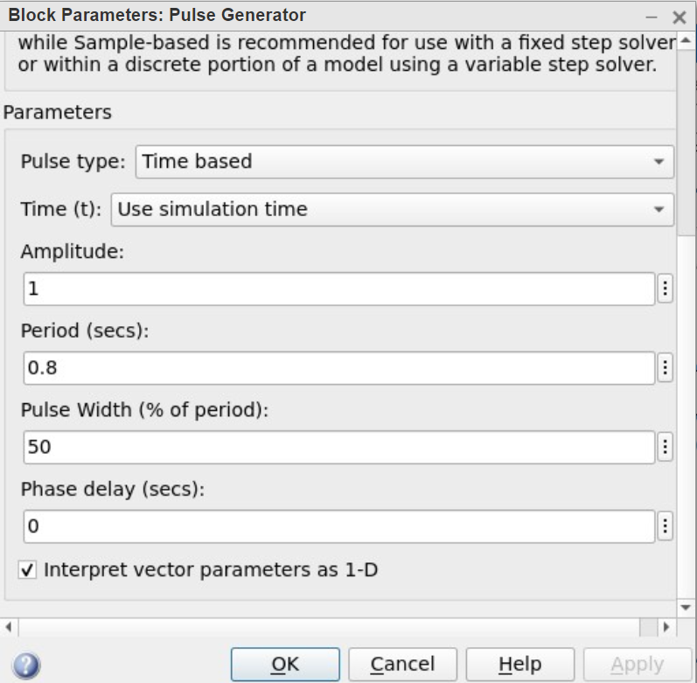
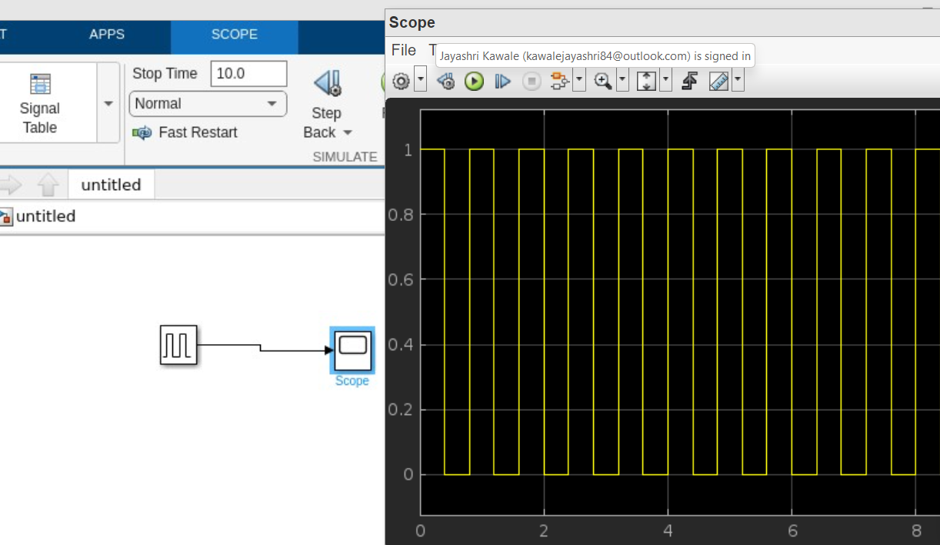
Pulse Generator:

Slide 7
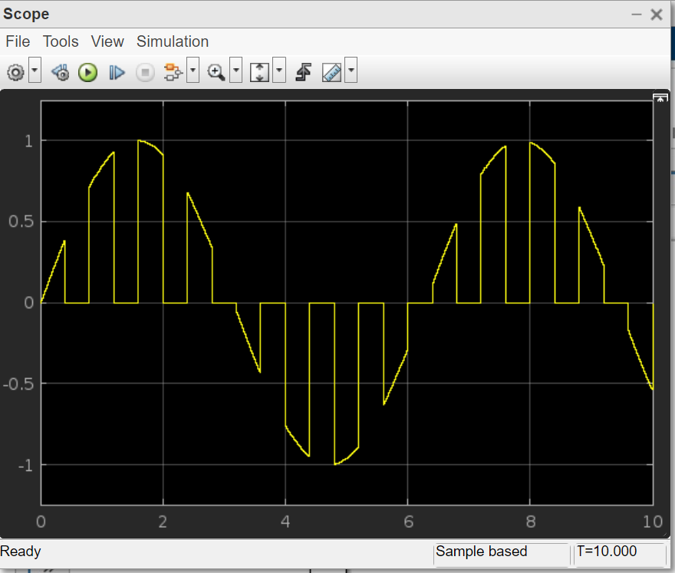
PAM Output:

Slide 8
PAM Modulation and Demodulation:

Slide 9
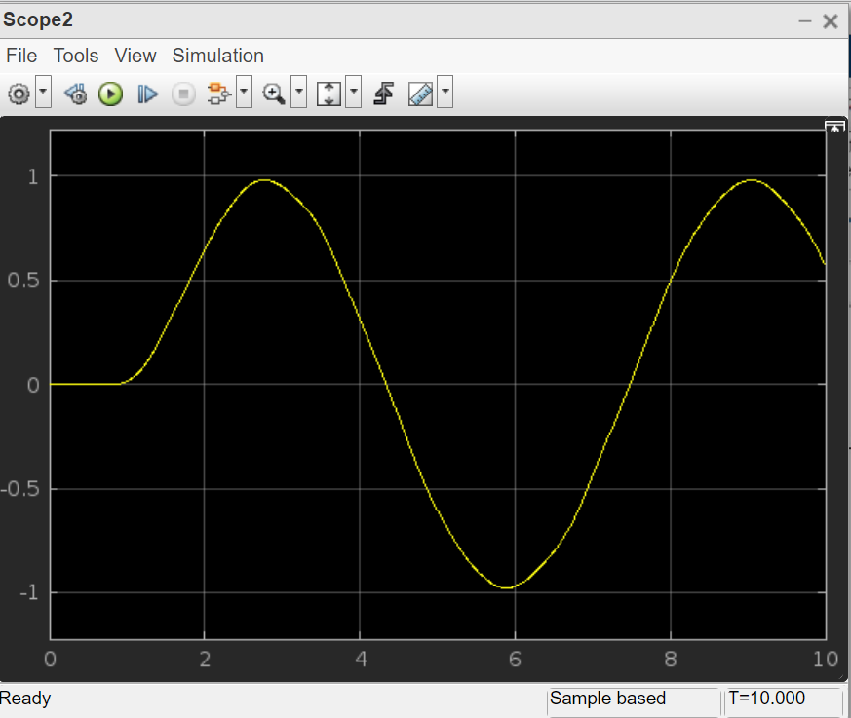
Demodulation Output:

Slide 10
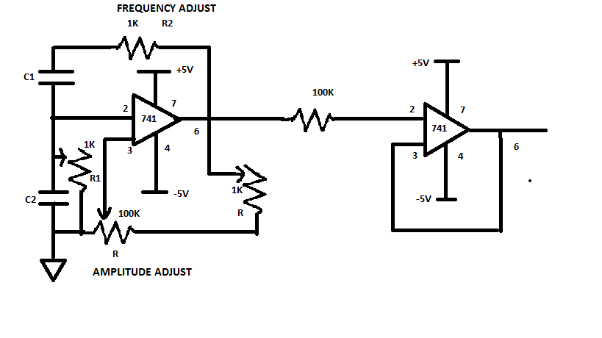
PAM Circuit:

Slide 11
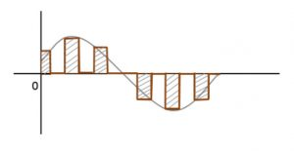
Flat Top PAM Natural PAM
Flat Top PAM
The amplitude of each pulse is directly proportional to modulating signal amplitude at the time of pulse occurrence. The amplitude of the signal cannot be changed with respect to the analog signal to be sampled. The tops of the amplitude remain flat.

Slide 12
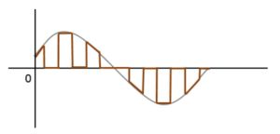
Natural PAM
The amplitude of each pulse is directly proportional to modulating signal amplitude at the time of pulse occurrence. Then follows the amplitude of the pulse for the rest of the half-cycle.

Slide 13

In Pulse modulation, the unmodulated carrier signal is a periodic train of signals. So the pulse train can be described like the following.
Pulse Train
Where ‘A’ is the unmodulated pulse amplitude

Slide 14
τ’ is pulse width
The pulse trains periodic time can be denoted as ‘Ts’
In PAM, the signal amplitudes can be changed based on the modulating signal. Here, the modulating signal like m(t), PAM can be achieved through multiplying the carrier signal with the modulating signal. The o/p is a set of pulses, where the amplitudes of signals can be changed on the modulating signal.
The specific type of PAM can be referred to as normal PAM, as the pulses follow the outline of the modulating signal. The pulse train works like a periodic switching signal toward the modulator. Once it is switched ON, and then allows the samples of modulating signals to supply toward the output. The pulse train’s periodic time is called the sampling period.
Fs = 1/Ts

Slide 15
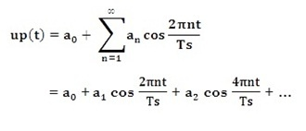
The natural pulse amplitude modulation equation can be described as the following.
The modulated pulse train can be described like
E(t) = m(t) +Up(t)
= a0 m(t) + a1 m(t) cos2πnt/Ts + a2 m(t) cos4πnt/Ts+….

Slide 16
Demodulation of PAM:
For the demodulation of the PAM signal, the PAM signal is fed to the low pass filter.
The low pass filter eliminates the high-frequency ripples and generates the demodulated signal.
This signal is then applied to the inverting amplifier to amplify its signal level to have the demodulated output with almost equal amplitude with the modulating signal.

Slide 17
MATLAB Code:
clc;
am = input('Enter the amplitude:');
fm= input('Enter frequency:');
t = 0:0.02:2;
x = 1;
subplot(3,1,1);
stem(x);
xlabel('Time');
ylabel('Amplitude');
title('Impulse Signal');
x2 = am*sin(2*pi*fm*t);

Slide 18
Continue…
subplot(3,1,2);
title('Sinusoidal Signal');
plot(t,x2);
ylim([-a-0.2 a+0.2])
xlabel('Time');
ylabel('Amplitude’);
y = x.*x2;
subplot(3,1,3);
title('PAM Waveform');
stem(t,y);
xlabel('Time');
ylabel('Amplitude');
ylim([-a-0.2 a+0.2])

Slide 19
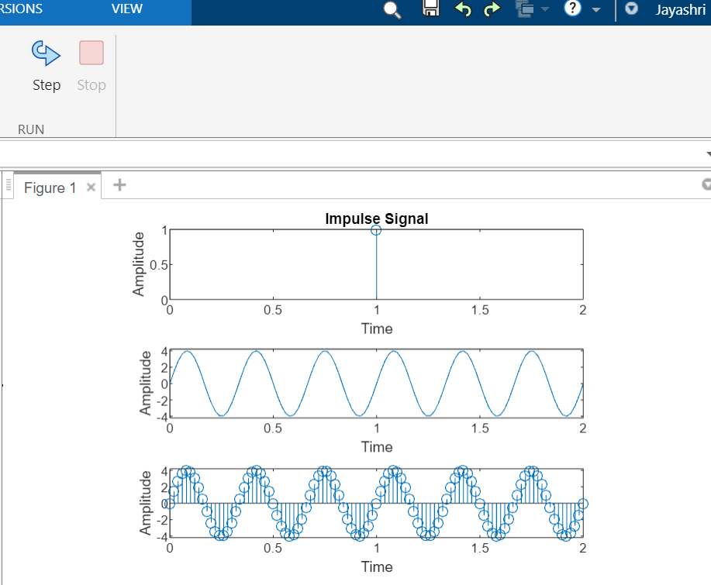
Output:

Slide 20
References:
[1] https://www.elprocus.com/pulse-amplitude-modulation/
[2] https://www.watelectronics.com/what-is-pulse-amplitude-modulation-its-working/

